Slide 1

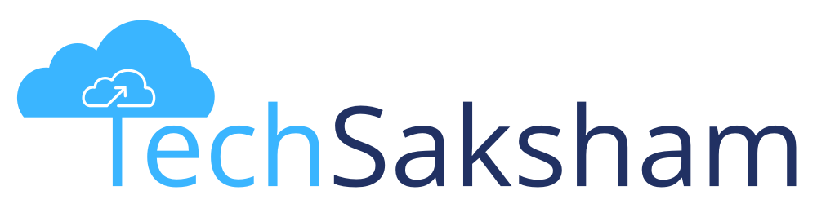



Basics of Cloud Computing
Notes:
STYLING WITH CSS

Slide 2
Disclaimer
The content is curated from online/offline resources and used for educational purpose only

Slide 3
Contents
Introduction to Microsoft Azure
Cloud Deployment and Service Delivery Models
Getting Started with an Azure Cloud
Fundamentals of Networking
Networking Protocols
Notes:
Our Contents for the following session is our discussion on:
Introduction to Microsoft Azure
Cloud Deployment and Service Delivery Models
Getting Started with an Azure Cloud
Fundamentals of Networking
Networking Protocols
Intro to Azure Virtual Network
Demo On Virtual Network
Demo on Deploying Linux Virtual Machine.
Market and JOB trends in Cloud

Slide 4

Learning Objectives
In this module, we will achieve following objectives.
Introduction to Cloud Computing as a domain.
Learning about Microsoft Azure Portal and offered services.
Working knowledge of networking protocols and integration to Azure services.
Real time implementation of services like virtual machines and virtual networks.
Understand the prospects with Cloud Computing.
Notes:
In this module, we will achieve following objectives.
Introduction to Cloud Computing as a domain.
Learning about Microsoft Azure Portal and offered services.
Working knowledge of networking protocols and integration to Azure services.
Real time implementation of services like virtual machines and virtual networks.
Understand the prospects with Cloud Computing.

Slide 5

Real-life examples and applications of Cloud Computing
Online Storage and Backup
Software as a Service (SaaS)
Streaming Services
Social Media
Gaming
E-commerce
Healthcare
Finance and Banking
Education
IoT (Internet of Things)
Collaboration Tools
Content Delivery Networks (CDNs)
Research and Scientific Computing
Government Services
Disaster Recovery and Business Continuity
Notes:
Cloud computing has found its way into numerous aspects of our lives and industries. Here are some real-life examples and applications of cloud computing:
1. Online Storage and Backup:
Cloud services like Dropbox, Google Drive, and OneDrive allow users to store and back up their files online, providing easy access from any device with an internet connection.
2. Software as a Service (SaaS):
Applications like Google Workspace (formerly G Suite), Microsoft Office 365, and Salesforce are delivered over the internet, allowing users to access and use software without installing it on their local devices.
3. Streaming Services:
Platforms like Netflix, Spotify, and Disney+ use cloud infrastructure to stream movies, music, and other media content to users on demand, without requiring users to download large files.
4. Social Media:
Social networking sites such as Facebook, Instagram, and Twitter use cloud computing to handle massive amounts of user data, posts, images, and videos, enabling seamless sharing and access from anywhere.
5. Gaming:
Cloud-based gaming services like Google Stadia, NVIDIA GeForce Now, and Xbox Cloud Gaming (formerly known as Project xCloud) allow gamers to play high-end games on various devices without needing powerful local hardware.
6. E-commerce:
Online shopping platforms like Amazon and eBay utilize cloud computing to manage product listings, inventory, user accounts, and transactions, ensuring smooth online shopping experiences.
7. Healthcare:
Electronic Health Record (EHR) systems enable healthcare providers to store and access patient records securely in the cloud, facilitating efficient data sharing and collaboration.
8. Finance and Banking:
Banks and financial institutions use cloud computing to process transactions, manage customer accounts, prevent fraud, and analyze financial data securely.
9. Education:
Online learning platforms such as Coursera, edX, and Khan Academy leverage cloud technology to deliver courses, store educational materials, and track student progress.
10. IoT (Internet of Things):
IoT devices, like smart thermostats, fitness trackers, and connected vehicles, often use cloud infrastructure to store and process the data they collect, enabling remote control and analysis.
11. Collaboration Tools:
Tools like Slack, Microsoft Teams, and Google Workspace facilitate remote collaboration by providing cloud-based communication, document sharing, and project management features.
12. Content Delivery Networks (CDNs):
CDNs, like Akamai and Cloudflare, use cloud resources to distribute web content to users from servers located strategically around the world, improving website performance and load times.
13. Research and Scientific Computing:
Cloud platforms offer researchers the ability to access powerful computing resources for simulations, data analysis, and complex calculations without having to invest in dedicated hardware.
14. Government Services:
Government agencies use cloud computing for services like tax processing, document storage, and citizen portals, enhancing accessibility and efficiency.
15. Disaster Recovery and Business Continuity:
Cloud-based backup and recovery solutions help businesses ensure data safety and operational continuity in case of hardware failures, natural disasters, or other emergencies.
These examples showcase the versatility and impact of cloud computing across various sectors, offering convenience, scalability, and cost-effectiveness to both individuals and organizations.

Slide 6
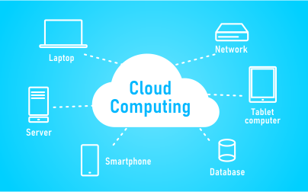
Cloud Computing
Cloud computing means providing software and hardware services over some network, mostly internet. These software and hardware services include compute services, storage, databases, and network services. All these services can be scaled up or down, as per user requirement, and are available on demand over some network.
Click here
Reference link
Notes:
Cloud Computing is a technology that acts as backbone for harnessing the power of all IR 4.0 like Artificial Intelligence, Internet of Things (IoT), web technologies, cyber security, blockchain, data analytics, Big Data, and so on.
In simple words, cloud computing means providing software and hardware services over some network, mostly internet. These software and hardware services include compute services, storage, databases, and network services. All these services can be scaled up or down, as per user requirement, and are available on demand over some network.

Slide 7

Introduction to Microsoft Azure
Microsoft Azure, as the name suggests, is a cloud platform from Microsoft.
It is a continually expanding set of cloud services that help an organization meet its current and future business challenges.
Notes:
Microsoft Azure, as the name suggests, is a cloud platform from Microsoft.
Microsoft Azure, one of the leading cloud computing platforms in the industry. Azure offers a vast array of services that enable businesses to build, deploy, and manage applications through Microsoft's global network of data centers. This presentation will provide an overview of Azure's key features, benefits, and use cases, shedding light on how it can accelerate innovation and scalability for organizations of all sizes. We'll explore its flexible infrastructure, extensive range of services, including virtual machines, databases, AI, and more. Additionally, we'll touch upon pricing models and the seamless integration with existing on-premises environments. By the end, you'll have a solid grasp of how Microsoft Azure is reshaping the IT landscape and revolutionizing the way we approach cloud computing.

Slide 8

Why Microsoft Azure?
Scenario: A group of students have a great business idea. They plan to develop it and start a production.
For that, they need to buy new Computing resources and a variety of software licences.
But, Buying and understanding the entire set up would be :
Time Consuming and Costly
Requires Physical Space with sufficient power and cooling
Notes:
Microsoft Azure is one of the latest cloud technology providers that gives enough flexibility in terms of infrastructure, cost and speed. Most of the companies are now migrating their applications and data to the cloud. Let's try to understand why do we need cloud computing with the help of this simple scenario. Let's have a look at this scenario.
Let's say, there is A group of students have a great business idea. They plan to develop it and start a production.
But wait, For that, they need to buy new Computing resources and a variety of software licences.
So, Buying and understanding the entire set up would be:
Time Consuming and Costly
Requires Physical Space with sufficient power and cooling

Slide 9

Why Microsoft Azure?
Maintain and manage them requires experts
Acquire maximum computing resources than needed.
Ending up with less utilization.
Focusing more on troubleshooting at the infrastructure level than the end business goal.
Notes:
Let’s discuss why we use Microsoft Azure
Maintaining and managing the infrastructure requires technical experts
May be, they end acquiring maximum computing resources than the actual need that can lead to underutilization of the resources and increase in upfront cost.
They end on Focusing more on troubleshooting at the infrastructure level than the end business goal.
Can there be a possible solution? Yes there is one.

Slide 10

Microsoft Azure provides:
High availability
Scalability
Elasticity
Agility
Geo-distribution
Disaster recovery
Click here
Reference link
Notes:
The solution for all the problem discussed is Microsoft Azure.
Microsoft Azure comes to rescue in these scenario and that is why we need such a service provider of Cloud Computing today. But Why?
Because with Microsoft Azure you would get some exclusive benefits like:
High availability: Depending on the service-level agreement (SLA) that you choose, your cloud-based apps can provide a continuous user experience with no apparent downtime, even when things go wrong.
Scalability: Apps in the cloud can scale vertically and horizontally:
Scale vertically to increase compute capacity by adding RAM or CPUs to a virtual machine.
Scaling horizontally increases compute capacity by adding instances of resources, such as adding VMs to the configuration.
Elasticity: You can configure cloud-based apps to take advantage of autoscaling, so your apps always have the resources they need.
Agility: Deploy and configure cloud-based resources quickly as your app requirements change.
Geo-distribution: You can deploy apps and data to regional datacenters around the globe, thereby ensuring that your customers always have the best performance in their region.
Disaster recovery: By taking advantage of cloud-based backup services, data replication, and geo-distribution, you can deploy your apps with the confidence that comes from knowing that your data is safe in the event of disaster.
These points definitely make anyone curious about cloud computing and Microsoft Azure.

Slide 11
Cloud Deployment and Service Delivery Models
Notes:
Cloud Deployment and Service Delivery Models
In the realm of cloud computing, deployment and service delivery models play a crucial role in shaping how businesses leverage cloud resources. There are primarily three deployment models: Public Cloud, Private Cloud, and Hybrid Cloud. Each model offers distinct advantages and considerations based on an organization's requirements.

Slide 12
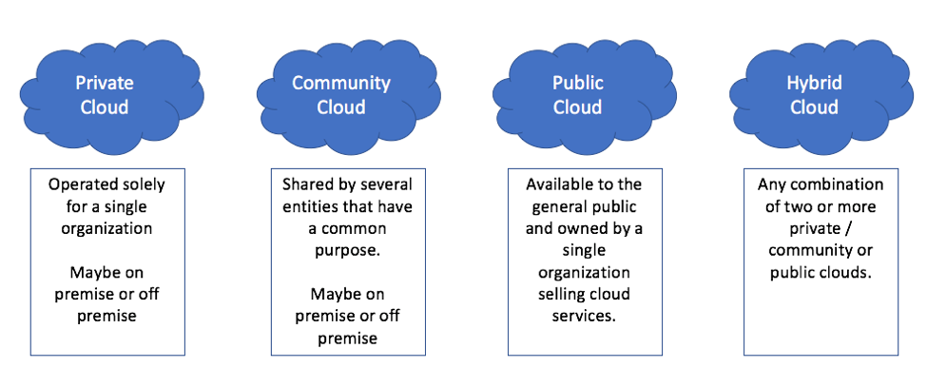
Cloud Computing Deployment Models
Click here
Reference link
Notes:
On the other hand, service delivery models define the type of services provided by the cloud, categorized into three main models: Infrastructure as a Service (IaaS), Platform as a Service (PaaS), and Software as a Service (SaaS). These models cater to different levels of control and responsibility, allowing businesses to select the most suitable approach for their operations. In this presentation, we'll delve into the specifics of each deployment and service delivery model, highlighting their benefits, use cases, and potential challenges. This understanding is essential for making informed decisions when adopting cloud solutions.
Lets look into each one of them more closely.

Slide 13

Private Cloud
The cloud services are offered on a private infrastructure.
Most of the times private cloud is for internal developers
Misses most if not all the benefits of the cloud.
Similar to an on-premise data center.
Notes:
The concept of a private cloud represents a cloud computing environment dedicated to a single organization. Unlike public clouds, private clouds are not shared with other companies, offering enhanced control, security, and customization. They can be hosted on-premises or by third-party providers, catering to organizations with stringent data privacy and compliance requirements. Private clouds enable businesses to maintain complete control over their infrastructure, resources, and networking. This level of control comes with the ability to fine-tune performance, security protocols, and resource allocation. While private clouds offer unparalleled security benefits, they also demand higher upfront costs for infrastructure setup and maintenance. During this discussion, we will delve deeper into the advantages, challenges, and considerations associated with private cloud adoption, helping you determine if this model aligns with your organization's strategic goals.

Slide 14

Community Cloud
Specific group of users band together to build a community cloud
Like a private club cloud.
Not a go to concept.
Notes:
When you talk about community cloud they are specific to a community.
they are also similar to a private club cloud. As in private club, a member can only come in or if anyone wants to be a member of that club he needs to fulfill certain formalities.
Similarly community cloud was more common to universities and research groups.
This type of cloud deployment model was used when cloud was much of a hobby activity. cloud enthusiasts band together and usually form a community cloud.
This was common a decade ago. Not a go to concept, today.

Slide 15
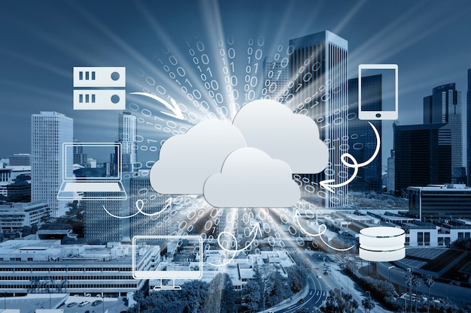
Public Cloud
Most common form of cloud deployment.
Every online user is using at least a few services deployed on public cloud.
Accessible through the public Internet.
Notes:
Public cloud
The common model that we all know. If you are using Internet or any known cloud services and you have not subscribed to it then most probably you are using public cloud.
Every online user is using at least a few services deployed on public cloud. Virtually all cloud computing today is deployed according to this model. since this is the cheaper one
Accessible through the public Internet. One can easily log into the services either with their credentials or even without credentials, if the service supports.

Slide 16

Hybrid Cloud
The hybrid cloud combines and unifies public cloud, private and on-premises infrastructure to create a single, flexible and cost optimal IT infrastructure.
With hybrid cloud business objective can be achieved more effectively and efficiently than public or private cloud.
Notes:
Hybrid cloud
The hybrid cloud combines and unifies public cloud, private and on-premises infrastructure to create a single, flexible and cost optimal IT infrastructure.
Let's say for your deployment model you need some services of private cloud and some services of public cloud. What would you do? Obviously, so you would merge the two cloud components together.
And this deployment model would be called as hybrid cloud.
Initially, this was not a very relevant as per the NIST formulation but today we see a lot of companies, organization mapping together to form a hybrid cloud of their requirements.
With hybrid cloud business objective can be achieved more effectively and efficiently than public or private cloud.

Slide 17
Three service models
Infrastructure as a Service (IaaS)
Platform as a Service(PaaS)
Software as a Service (SaaS)
Note: Boundaries between them are breaking down.
Notes:
The services of cloud model can be deployed in three forms or as we call them as three service models they are
Infrastructure as a Service (IaaS)
Platform as a Service(PaaS)
Software as a Service (SaaS)
This is to remember that the cases would be different in today's world.
The boundaries which separated them are blurring down and people do have service models which can be a combination of one or more service models.
Let's look into each one of them in detail.

Slide 18

Infrastructure as a Service (IaaS)
The most basic form services
Virtual hardware resources and system software.
The consumer installs and manages the needed software.
High Control but high engagement.
Notes:
The first one is the Infrastructure as a Service (IaaS)
The most basic form of cloud services you can also see this as the ground layer.
Basic computing resources are provided such as different type of hardware and system software.
Based on the individual requirements, The consumer installs and manages the needed software.
High Control but high engagement. This means the user has higher control over the virtualized machine but the end user also has to manage different services and software.

Slide 19

Platform as a Service(PaaS)
Can be used to develop applications by the service consumer
Allows to write code and configure the service
Vendor manages the underlying infrastructure
Notes:
The second is the Platform as a Service(PaaS)
This model can be used to develop applications by the consumer, which in most of the cases, are the programmers and developers of the industry.
Allows to write code and configure the service. Here one can choose the development environment.
Vendor or the service provider manages the underlying infrastructure. Remember the underlying infrastructure is not visible to the user in case of platform as a service.

Slide 20
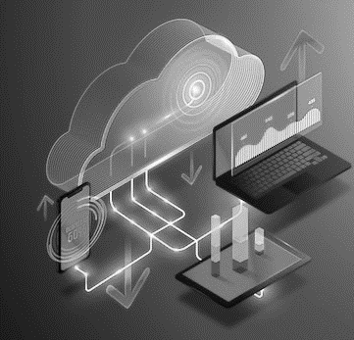
Software as a Service (SaaS)
Everything is managed by the vendor
You only configure and use it through a web browser.
Common examples are Google’s services like Docs, Calendar, and Sheets or Microsoft’s Office 365.
These provide the user with only limited options to configure the software.
Notes:
The third one is Software as a Service (SaaS)
Everything is managed by the vendor or the service provider
You only configure and use it through a web browser. As we do with the websites.
Common examples are Google’s services like Docs, Calendar, and Sheets or Microsoft’s Office 365.
These provide the user with only limited options to configure the software.

Slide 21

Fundamentals of Networking
Notes:
Fundamentals of Networking

Slide 22
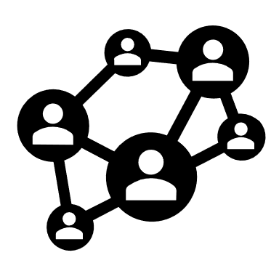
Fundamentals of Networking
When you connect two or more than two computing devices together, they become connected by a network.
This connection may be wired or wireless.
The connection, maintenance and administration of this network is called Networking.
Notes:
When you connect two or more than two computing devices together, they become connected by a network. This connection may be wired or wireless. The wired medium may be an ethernet cable or fiber connection. Similarly, wireless medium may be Wi-Fi, Bluetooth or any other radio wave based. The connection, maintenance and administration of this network is called Networking.

Slide 23

Types of Networks
There are various types of networks. This is based on coverage. The types are as follows:
LAN aka Local Area Network
MAN, aka Metropolitan Area Network
WAN aka Wide Area Network
Notes:
Types of Networks
There are various types of networks. This is based on coverage. The types are as follows:
LAN aka Local Area Network. This is the smallest form of Network. Usually, two or more devices may be connected via ethernet cable or wireless network device such as hub or switch. In our labs, homes, colleges the network that we have is of LAN type. The radius of such a network is generally not more than 2KM.
MAN, aka Metropolitan Area Network. This type of network is larger than LAN. This may spread in a larger area such as a metropolitan city or in our case a colony. This is more of an abstract concept because when it was designed it was meant to support a city. However, nowadays instead of opting for a MAN we usually go for a more commonly used type of network that we called as the Internet. The Internet is also an example of WAN.
WAN, aka Wide Area Network. The best example of this type is the World Wide Web, also known as the Internet. Whenever you are using any app to connect to a server, you would probably be using the Internet.

Slide 24
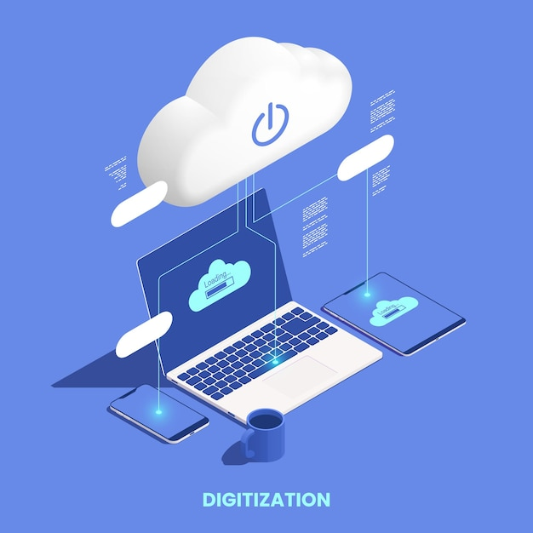
Topologies
Topology is about the logical pattern of connection. There are six types of topologies.
Bus Topology
Ring Topology
Star Topology
Tree Topology
Mesh Topology
Hybrid Topology
Notes:
Topology is about the logical pattern of connection. There are six types of topologies.
Bus Topology: The systems are connected with a common data transfer line. The layout is cheap but vulnerable to failure and only suitable for low traffic volumes. This is not used for colleges/office networks today, but can still be found within some consumer products.
Ring Topology: This is an advanced version of Bus topology where devices are connected in a logical circle or ring format. It is easy to manage and with a low risk of collision but reliant on all nodes being powered up and in full working order.
Star Topology: int his topology, all devices are connected to a central switch, which makes it easy to add new nodes without rebooting all currently connected devices. This topology makes efficient use of cable and is easy to administer. On the other hand, the health of the switch is vital. This topology requires monitoring and maintenance. However, it is a commonly used topology.
Tree Topology: it is a hierarchical layout that links together groups of nodes. Creates parent-child dependencies between root nodes and regular nodes. This layout can be vulnerable to failure if a root node has a problem. This topology is complicated and difficult to manage and it uses a lot of cable.
Mesh Topology: Each node is connected to every other mode with a direct link. This topology is also known to have peer2peer connections. This topology creates a very reliable network, but requires a large amount of cable and is difficult to administer. Wifi networks make this topology more feasible.
Hybrid Topology: Combines two or more of the standard topologies. This can be a good solution to create quickly link together different existing networks into a unified system.
Now lets understand the protocols which ensure the communication in a network.

Slide 25
Networking Protocols
Notes:
Next topic we will discuss is Networking Protocols.

Slide 26
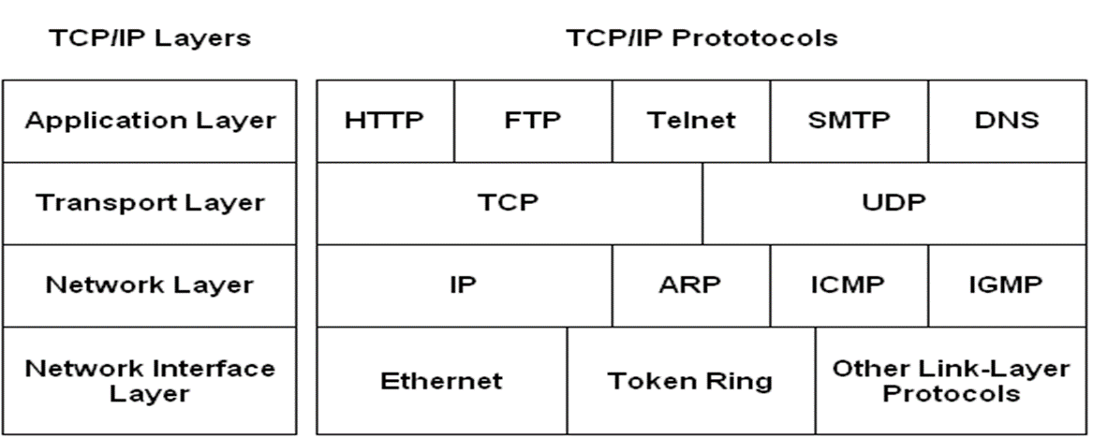
Networking Protocols
The TCP/IP suite is named after its most important protocols, the Transmission Control Protocol (TCP) and the Internet Protocol (IP).
Notes:
There are different protocols present at each layer of TCP/IP Suite.
A network protocol is an established set of rules that determine how data is transmitted between different devices in the same network.
Network protocols divide the communication process into discrete tasks across every layer of the TCP/IP model.
Some of the important protocols included in the TCP/IP suite are as follows:
•ARP(Address Resolution Protocol) is used to associate an IP address with a MAC address.
•IP (Internet Protocol) is used to deliver packets from the source host to the destination host based on the IP addresses.
•Telnet(Telecommunication Network) –is used to connect and issue commands on a remote computer.
•DNS(Domain Name System) – is used for host names to the IP address resolution.
•HTTP(Hypertext Transfer Protocol) is used to transfer files (text, graphic images, sound, video, and other multimedia files) on the World Wide Web.

Slide 27
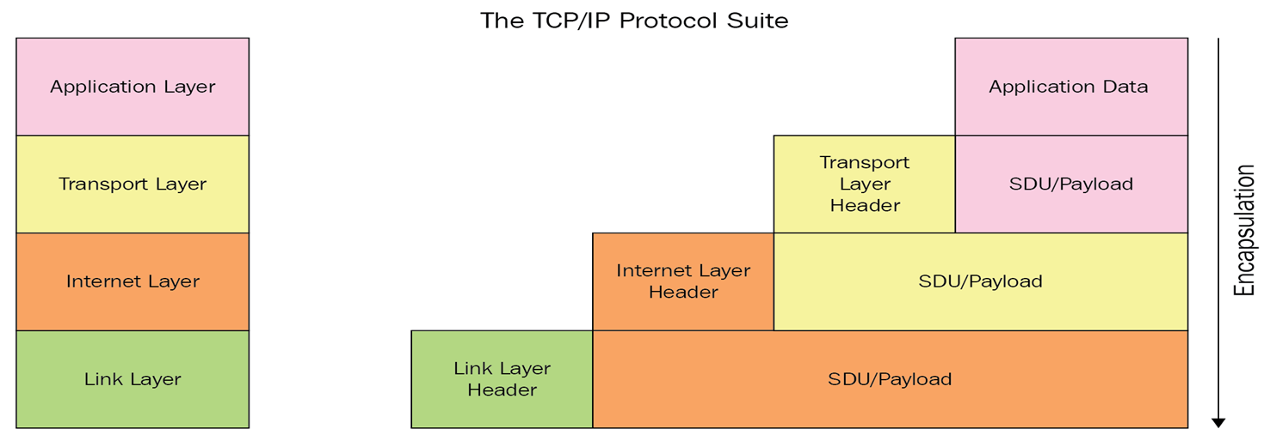
TCP/IP Suits
Click here
Reference link
Notes:
Let us discuss about TCP/IP Protocol suite:
What is a Protocol ?
A protocol is a set of rules that govern how systems communicate. For networking they govern how data is transferred from one system to another.
What is a Protocol Suite ?
A protocol suite is a collection of protocols that are designed to work together.
TCP/IP was designed to be independent of networking Hardware and should run across any connection media.
The protocol suite is named after two of the most common protocols – TCP (transmission Control Protocol) and IP (internet Protocol).
TCP/IP suite is set of protocols used on computer networks to provide end-to-end connectivity by specifying how data should be packetized, addressed, transmitted, routed and received on a network.
The functionality of TCP/IP suite resides in four layers.
•Application Layer
•Transport Layer
•Internet/Network Layer
•Network access Layer
•
One of the main example of WAN is internet which connect billions of devices globally. Internet follows the standard protocols that facilitates the communication between these networking devices.
TCP/IP suite is set of protocols used on computer networks to provide end-to-end connectivity by specifying how data should be packetized, addressed, transmitted, routed and received on a network. The functionality of TCP/IP suite resides in four layers.
•Application layer: The top layer of this stack is concerned with application or process communication. When one application layer protocol needs to communicate with another application layer, it forwards its information to the transport layer.
•Transport layer: This layer is responsible for host-to-host communication on the network. It is responsible for reliability, flow control and correction of data that is being sent over the internet. There are two protocols used in this layer are User Datagram Protocol and Transmission control protocol.
•Internet/Network layer: This layer is responsible for exchanging datagrams. Here, the main responsibility is to send packets from any network and they arrive at destination irrespective of route they take.
•Network access layer: The bottom layer of this stack is responsible for defining how the data is sent across the network. Main responsibility is the transmission of the information over the same network between two devices.
•

Slide 28
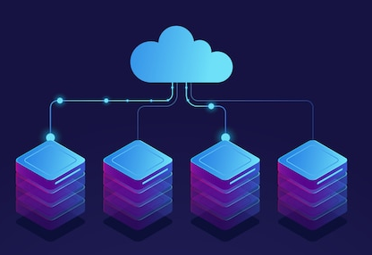
Transmission Control Protocol(TCP) and User Datagram Protocol (UDP)
TCP is connection-oriented communication protocol
User Datagram Protocol (UDP)
Notes:
TCP and UDP
TCP is connection-oriented communication protocol - it facilitates the exchange of messages between computing devices in a network by establishing virtual connection between two hosts
User Datagram Protocol (UDP) is a communication protocol that is primarily used to establish low-latency and loss-tolerating connections between applications on the internet.

Slide 29

Transmission Control Protocol (TCP) Features
Establishes a Session
Ensures Reliable Delivery
Provides Same-Order Delivery
Supports Flow Control
Notes:
Let us discuss Transmission Control Protocol Features
We Will discuss four features one by one
Establishes a Session - TCP is a connection-oriented protocol that negotiates and establishes a permanent connection (or session) between source and destination devices prior to forwarding any traffic.
Ensures Reliable Delivery - For many reasons, it is possible for a segment to become corrupted or lost completely, as it is transmitted over the network. TCP ensures that each segment that is sent by the source arrives at the destination.
Provides Same-Order Delivery - Because networks may provide multiple routes that can have different transmission rates, data can arrive in the wrong order.
Supports Flow Control - Network hosts have limited resources (i.e., memory and processing power). When TCP is aware that these resources are overtaxed, it can request that the sending application reduce the rate of data flow.

Slide 30
User Datagram Protocol (UDP) Features
UDP features include the following :
Connection status
Data sequencing
Guaranteed delivery
Retransmission of data
Error checking
Method of transfer
Speed
Broadcasting
Optimal use
Notes:
Now come to features of UDP (User Datagram Protocol)
Connection Status: Connectionless protocol with no requirements for opening, maintaining, or terminating a connection
Data sequencing: Unable to sequence the packets which is arriving at the receiver side.
Guaranteed delivery: Cannot guarantee delivery of data to the destination.
Retransmission of data: No retransmission of lost packets.
Error checking: Basic error checking mechanism using checksums.
Method of transfer: UDP packets with defined boundaries; sent individually and checked for integrity on arrival.
Speed: UDP is faster than TCP.
Broadcasting: Does support Broadcasting.
Optimal use: Video conferencing, streaming, DNS, VoIP, etc.

Slide 31

Internet Protocol
IP stands for internet protocol.
IP specifies formats of packets also called as datagrams and the addressing scheme.
Most networks combines IP with higher level protocol called Transmission Control Protocol which establish virtual connection between destination and source.
Notes:
TCP and IP are two separate computer network protocols.
IP is the part that obtains the address to which data is sent. TCP is responsible for data delivery once that IP address has been found.
It's possible to separate them, but there isn’t really a point in making a difference between TCP and IP. Because they're so often used together, “TCP/IP” and the “TCP/IP model” are now recognized terminology.
Think of it this way: The IP address is like the phone number assigned to your smartphone. TCP is all the technology that makes the phone ring, and that enables you to talk to someone on another phone. They are different from one another, but they are also meaningless without one another.
Let us discuss more about network layer protocol that is internet protocol.
•The Internet Protocol (IP) is a protocol, or set of rules, for routing and addressing packets of data so that they can travel across networks and arrive at the correct destination.
• Data traversing the Internet is divided into smaller pieces, called packets.
• IP information is attached to each packet, and this information helps routers to send packets to the right place. Every device or domain that connects to the Internet is assigned an IP address, and as packets are directed to the IP address attached to them, data arrives where it is needed.
•Once the packets arrive at their destination, they are handled differently depending on which transport protocol is used in combination with IP. The most common transport protocols are TCP and UDP.

Slide 32
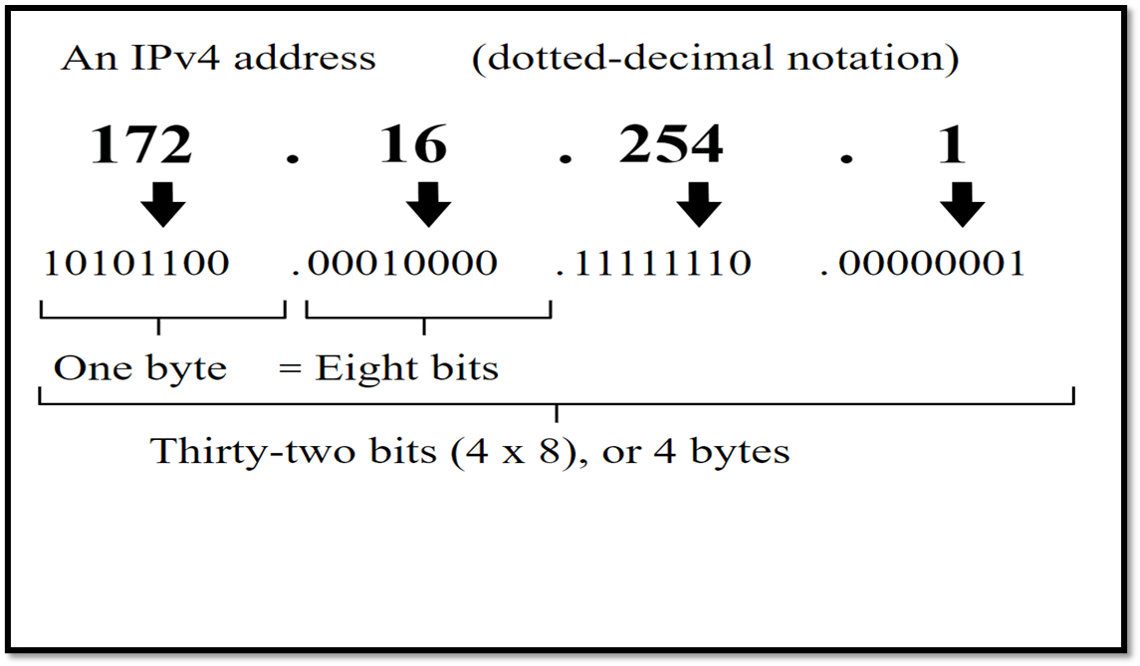
What is Internet Protocol ?
An IP address is a unique identifier assigned to a device or domain that connects to the Internet. An IP address can contain information about its network, sub network and host.
Click here
Reference link
Notes:
Let us understand IP Address and its structure.
An IP address is a unique identifier assigned to a device or domain that connects to the Internet.
Let us understand IP address by using an analogy, if anyone wants to send letter to your home then that person should know your home address in the same way your computer should also have IP address if any computer wants to communicate with it to share any information over the internet
An IP address consists of 32 bits. These bits are divided into four sections. Sections are separated by a dot (.). Each section contains 8 bits. 8 bits are equal to 1 byte or 1 octet. This is notation of IPv4 type of IP address.
An IP address can contain information about its network, sub network and host. A network can have many subnetworks in turn many sub networks can have many hosts.
There is another type of IP address that is IPv6 because IPv4 address can only connect 4 billion devices uniquely over the internet and there are many devices to be connected to the internet. So we are gradually moving towards IPv6 which 128-bit IP address, it means, a total of 2^128 devices can be assigned unique IP addresses.

Slide 33
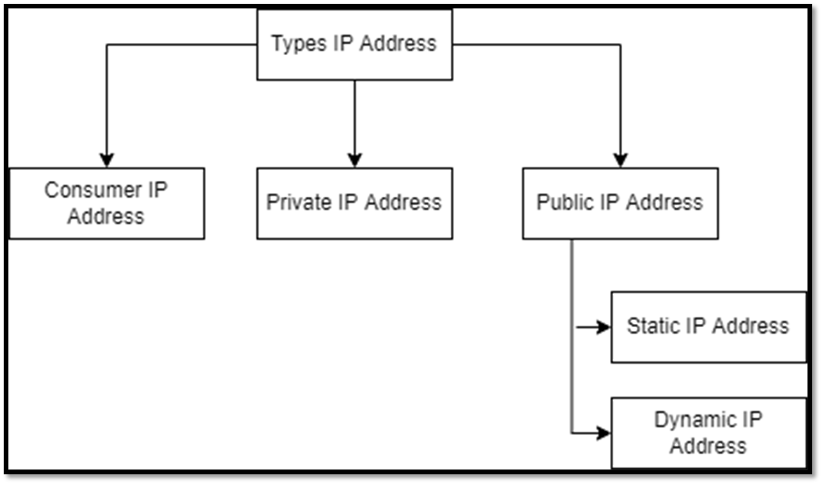
Types of Internet Protocol
Notes:
Now moving to the next part of IP addressing is: Types of IP address
There are different categories of IP addresses, and within each category, different types.
Consumer IP addresses
Every individual or business with an internet service plan will have two types of IP addresses: their private IP addresses and their public IP address. The terms public and private relate to the network location — that is, a private IP address is used inside a network, while a public one is used outside a network.
Private IP addresses
Every device that connects to your internet network has a private IP address. This includes computers, smartphones, and tablets but also any Bluetooth-enabled devices like speakers, printers, or smart TVs. With the growing internet of things, the number of private IP addresses you have at home is probably growing. Your router needs a way to identify these items separately, and many items need a way to recognize each other. Therefore, your router generates private IP addresses that are unique identifiers for each device that differentiate them on the network.
Public IP addresses
A public IP address is the primary address associated with your whole network. While each connected device has its own IP address, they are also included within the main IP address for your network. As described above, your public IP address is provided to your router by your ISP. Typically, ISPs have a large pool of IP addresses that they distribute to their customers. Your public IP address is the address that all the devices outside your internet network will use to recognize your network.
Public IP addresses
Public IP addresses come in two forms – dynamic and static.
1. Static IP Address-
Static IP Address is an IP Address that once assigned to a network element always remains the same.
·They are configured manually.
. Dynamic IP Address-
Dynamic IP Address is a temporarily assigned IP Address to a network element.
·It can be assigned to a different device if it is not in use.
·DHCP or PPPoE assigns dynamic IP addresses.

Slide 34
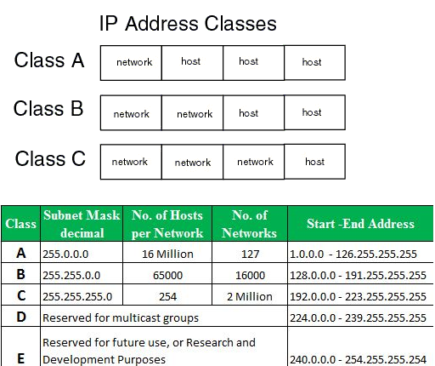
Classes of IPv4 Address
Classes of IPV4 Address
Notes:
Let us understand IP Address and its structure.
An IP address is a unique identifier assigned to a device or domain that connects to the Internet.
Let us understand IP address by using an analogy, if anyone wants to send letter to your home then that person should know your home address in the same way your computer should also have IP address if any computer wants to communicate with it to share any information over the internet
An IP address consists of 32 bits. These bits are divided into four sections. Sections are separated by a dot (.). Each section contains 8 bits. 8 bits are equal to 1 byte or 1 octet. This is notation of IPv4 type of IP address.
An IP address can contain information about its network, sub network and host. A network can have many subnetworks in turn many sub networks can have many hosts.
There is another type of IP address that is IPv6 because IPv4 address can only connect 4 billion devices uniquely over the internet and there are many devices to be connected to the internet. So we are gradually moving towards IPv6 which 128-bit IP address, it means, a total of 2^128 devices can be assigned unique IP addresses.

Slide 35
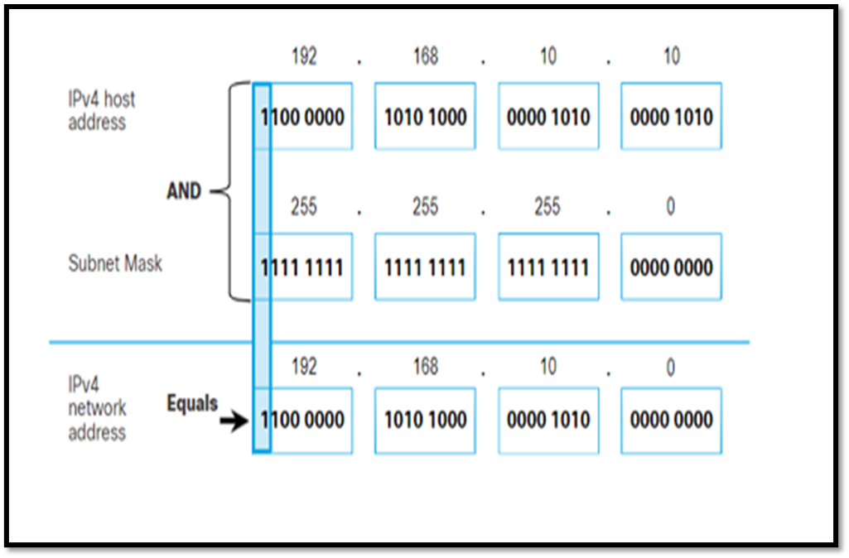
Subnet Mask
A subnet mask is a 32-bit number created by setting host bits to all 0s and setting network bits to all 1s.
Routers use subnet mask to distinguish between host and network address.
It extracts network address from the given IP address.
Notes:
Let's Discuss Subnet Mask
A subnet mask is a 32-bit number created by setting host bits to all 0s and setting network bits to all 1s. In this way, the subnet mask separates the IP address into the network and host addresses.
The “255” address is always assigned to a broadcast address, and the “0” address is always assigned to a network address. Neither can be assigned to hosts, as they are reserved for these special purposes.
The IP address, subnet mask and gateway or router comprise an underlying structure—the Internet Protocol—that most networks use to facilitate inter-device communication.
When organizations need additional subnetworking, subnetting divides the host element of the IP address further into a subnet. The goal of subnet masks are simply to enable the subnetting process. The phrase “mask” is applied because the subnet mask essentially uses its own 32-bit number to mask the IP address.

Slide 36
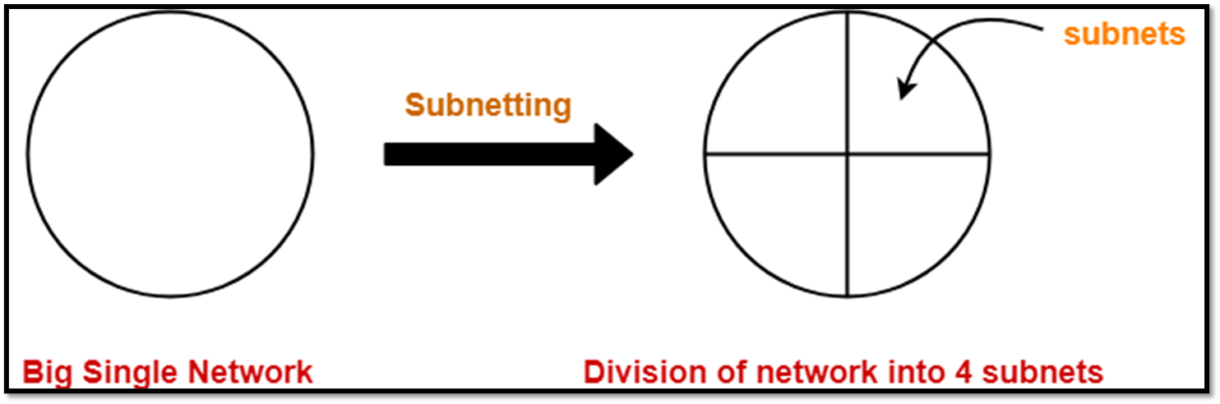
Subnetting
Example of Subnetting
Notes:
First we discuss, Why subnetting is required.
One goal of a subnet is to split a large network into a grouping of smaller, interconnected networks to help minimize traffic. This way, traffic doesn't have to flow through unnecessary routs, increasing network speeds. Subnetting, the segmentation of a network address space, improves address allocation efficiency.
Let us understand with example:
suppose in a college there are four categories such as hostel, admin, HR, teachers. suppose we want that the communication in between all the parts would not interfere with each other then we divide the network into four parts and this is know as subnet. A network having four parts. One for Hostel, one for admin, another for HR and last is for teachers.
Lets discuss about subnetting
In networking,
·The process of dividing a single network into multiple sub networks is called as subnetting.
·The sub networks so created are called as subnets.
Subnet ID-
Each subnet has its unique network address known as its Subnet ID.
·The subnet ID is created by borrowing some bits from the Host ID part of the IP Address.
·The number of bits borrowed depends on the number of subnets created.
·

Slide 37
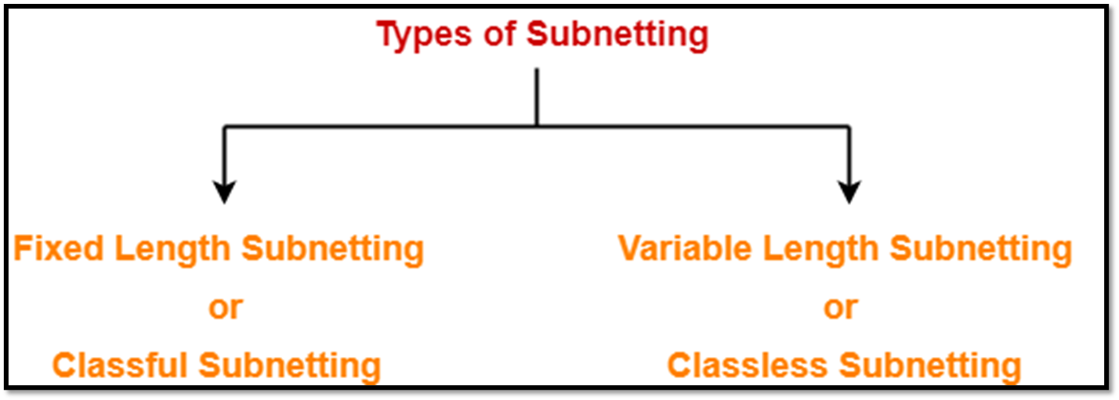
Types of Subnetting
Types of Subnetting
Notes:
Types of Subnetting
Subnetting of a network may be carried out in the following two ways-
1. Fixed Length Subnetting-
Fixed length subnetting also called as classful subnetting divides the network into subnets where-
·All the subnets are of same size.
·All the subnets have equal number of hosts.
·All the subnets have same subnet mask.
2. Variable Length Subnetting-
Variable length subnetting also called as classless subnetting divides the network into subnets where-
·All the subnets are not of same size.
·All the subnets do not have equal number of hosts.
·All the subnets do not have same subnet mask.

Slide 38
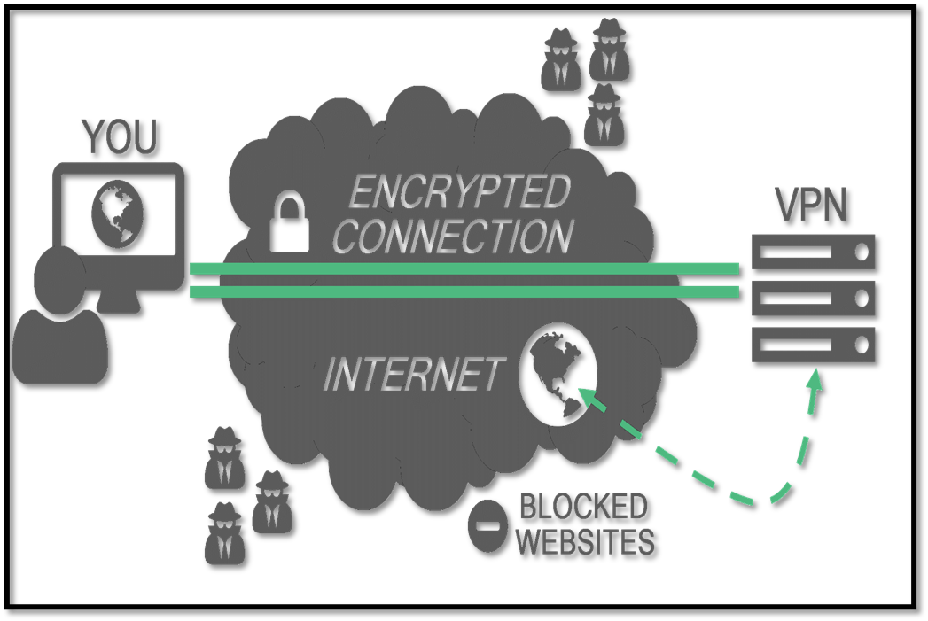
Virtual Private Network
A virtual private network, or VPN, is an encrypted connection over the Internet from a device to a network.
Notes:
A virtual private network, or VPN, is an encrypted connection over the Internet from a device to a network.
VPN uses several important TCP/IP protocols to protect data traffic. Like
•IP Security protocols Key management Layer 2 Tunnel Protocol Network address translation for VPN NAT compatible IPSec with UDP IP Compression VPN and IP filtering
A virtual private network, or VPN, is an encrypted connection over the Internet from a device to a network. VPN encrypts your internet traffic and disguise your online identity. So, it becomes very difficult for third parties to track your online activities and steal your data.

Slide 39
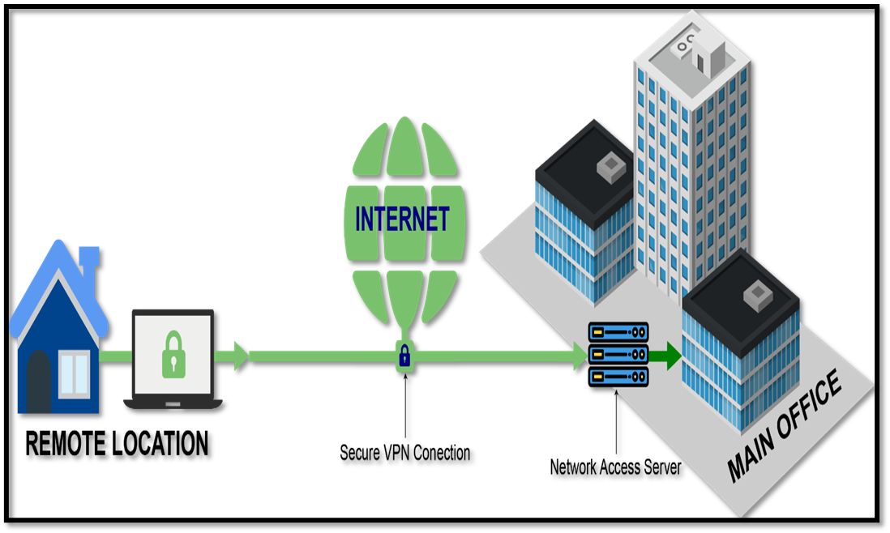
Types of Virtual Private Network
Remote access
A remote access VPN securely connects a device outside the corporate office.
Click here
Reference link
Notes:
Let us discuss about types of VPN.
Remote access in VPN enables secure connections for off-site individuals. Users initiate a connection via VPN client, establishing an encrypted tunnel over the internet. Authentication ensures authorized entry, limiting access to approved resources. All data traffic is encrypted, preventing interception. The VPN server acts as an exit point, allowing users to access internal networks remotely. This secure approach is vital for maintaining data privacy and network integrity.

Slide 40
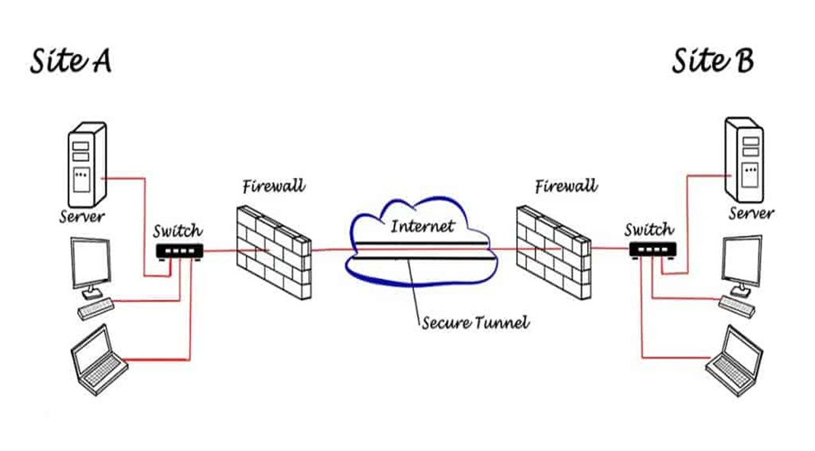
Types of Virtual Private Network
Site-to-site
A site-to-site VPN connects the corporate office to branch offices over the Internet.
Click here
Reference link
Notes:
Another type is Site-to-Site
A site-to-site VPN connects the corporate office to branch offices over the Internet.
Site-to-site VPNs connect distant networks securely. Routers or firewalls at each site establish an encrypted tunnel using protocols like IPsec. Data transmission occurs through this tunnel, shielding information from threats. Remote networks function as local extensions, facilitating resource sharing. This setup is crucial for businesses with multiple locations, ensuring private and seamless communication.

Slide 41

Benefits of Virtual Private Network
Secure encryption
Disguising your whereabouts
Access to regional content
Secure data transfer
Notes:
As we have discussed types of VPN. Now lets discuss the benefits of Virtual Private Network
·
·Secure encryption: To read the data, you need an encryption key. Without one, it would take millions of years for a computer to decipher the code in the event of a brute force attack . With the help of a VPN, your online activities are hidden even on public networks.
·Disguising your whereabouts : VPN servers essentially act as your proxies on the internet. Because the demographic location data comes from a server in another country, your actual location cannot be determined. In addition, most VPN services do not store logs of your activities. Some providers, on the other hand, record your behavior, but do not pass this information on to third parties. This means that any potential record of your user behavior remains permanently hidden.
·Access to regional content: Regional web content is not always accessible from everywhere. Services and websites often contain content that can only be accessed from certain parts of the world. Standard connections use local servers in the country to determine your location. This means that you cannot access content at home while traveling, and you cannot access international content from home. With VPN location spoofing , you can switch to a server to another country and effectively “change” your location.
·Secure data transfer: If you work remotely, you may need to access important files on your company’s network. For security reasons, this kind of information requires a secure connection. To gain access to the network, a VPN connection is often required. VPN services connect to private servers and use encryption methods to reduce the risk of data leakage.

Slide 42
Benefits of Virtual Private Network
Encryption of your IP address
Encryption of protocols
Kill switch
Two-factor authentication
Notes:
Moving to the next part
Features of VPN
·Encryption of your IP address: The primary job of a VPN is to hide your IP address from your ISP and other third parties. This allows you to send and receive information online without the risk of anyone but you and the VPN provider seeing it.
·Encryption of protocols: A VPN should also prevent you from leaving traces, for example, in the form of your internet history, search history and cookies. The encryption of cookies is especially important because it prevents third parties from gaining access to confidential information such as personal data, financial information and other content on websites.
·Kill switch: If your VPN connection is suddenly interrupted, your secure connection will also be interrupted. A good VPN can detect this sudden downtime and terminate preselected programs, reducing the likelihood that data is compromised.
·Two-factor authentication: By using a variety of authentication methods, a strong VPN checks everyone who tries to log in. For example, you might be prompted to enter a password, after which a code is sent to your mobile device. This makes it difficult for uninvited third parties to access your secure connection.

Slide 43
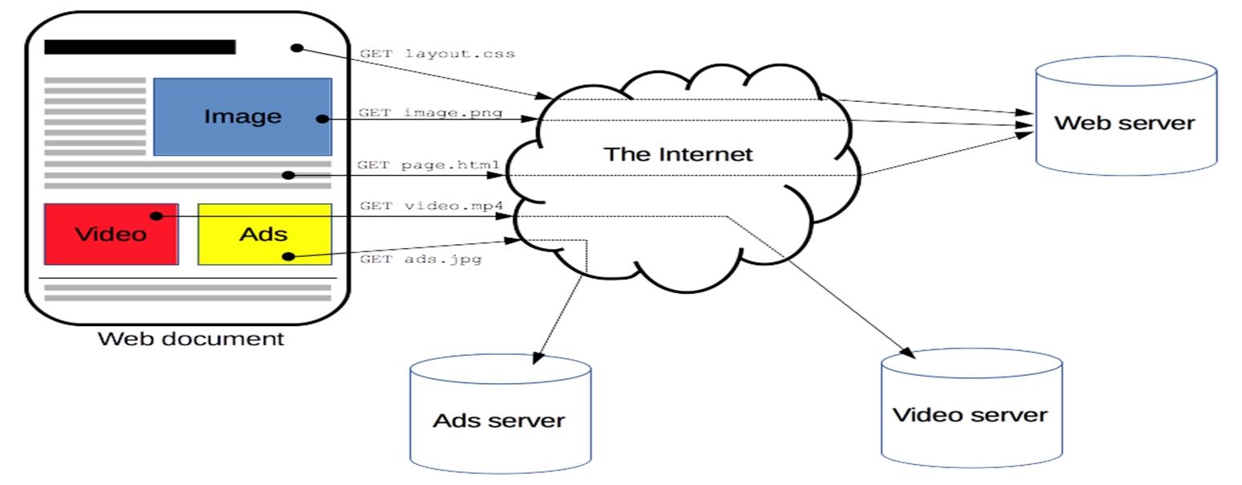
Hypertext Transfer Protocol
Notes:
Next topic which is required to understand is HTTP.
Hypertext Transfer Protocol (HTTP) is an application-layer protocol for transmitting hypermedia documents, such as HTML.
HTTP (Hypertext Transfer Protocol) is the set of rules for transferring files -- such as text, images, sound, video and other multimedia files -- over the web. As soon as a user opens their web browser, they are indirectly using HTTP.

Slide 44

Hypertext Transfer Protocol
The HTTPS protocol makes it possible for website users to transmit sensitive data such as credit card numbers, banking information, and login credentials securely over the internet.
For this reason, HTTPS is especially important for securing online activities such as shopping, banking, and remote work. However, HTTPS is quickly becoming the standard protocol for all websites, whether they exchange sensitive data with users.
Notes:
Next topic which is required to understand is HTTP.
Hypertext Transfer Protocol (HTTP) is an application-layer protocol for transmitting hypermedia documents, such as HTML.
HTTP (Hypertext Transfer Protocol) is the set of rules for transferring files -- such as text, images, sound, video and other multimedia files -- over the web. As soon as a user opens their web browser, they are indirectly using HTTP.

Slide 45
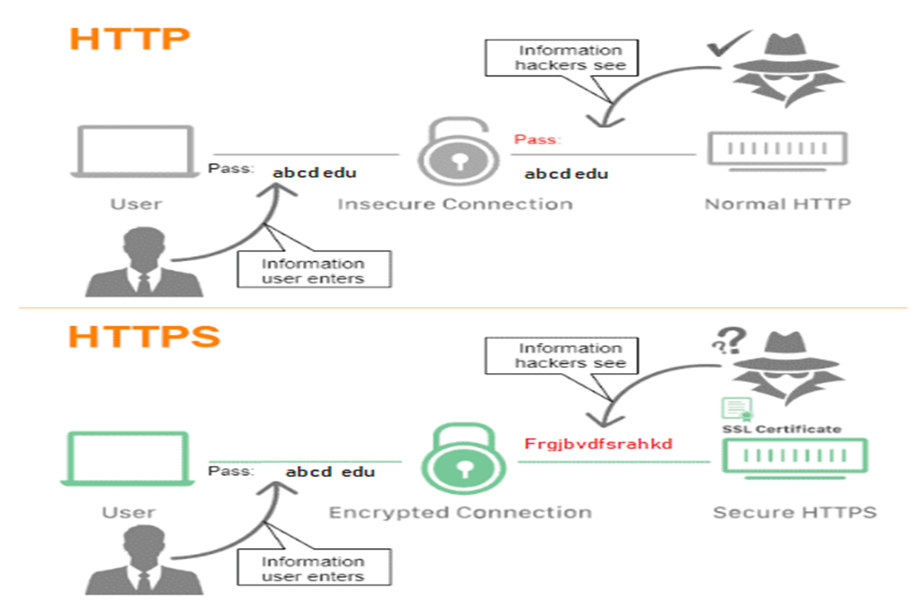
Secure Socket Layer
Notes:
SSL is the original name of the cryptographic protocol for authenticating and encrypting communications over a network. Officially, SSL was replaced by an updated protocol called TLS some time ago.
Secure Socket Layer (SSL)
The main responsibility of SSL is to ensure that the data transfer between the communicating systems is secure and reliable. It is the standard security technology that is used for encryption and decryption of data during the transmission of requests.
As discussed earlier, HTTPS is basically the same old HTTP but with SSL. For establishing a secure communication link between the communicating devices, SSL uses a digital certificate called SSL certificate.

Slide 46
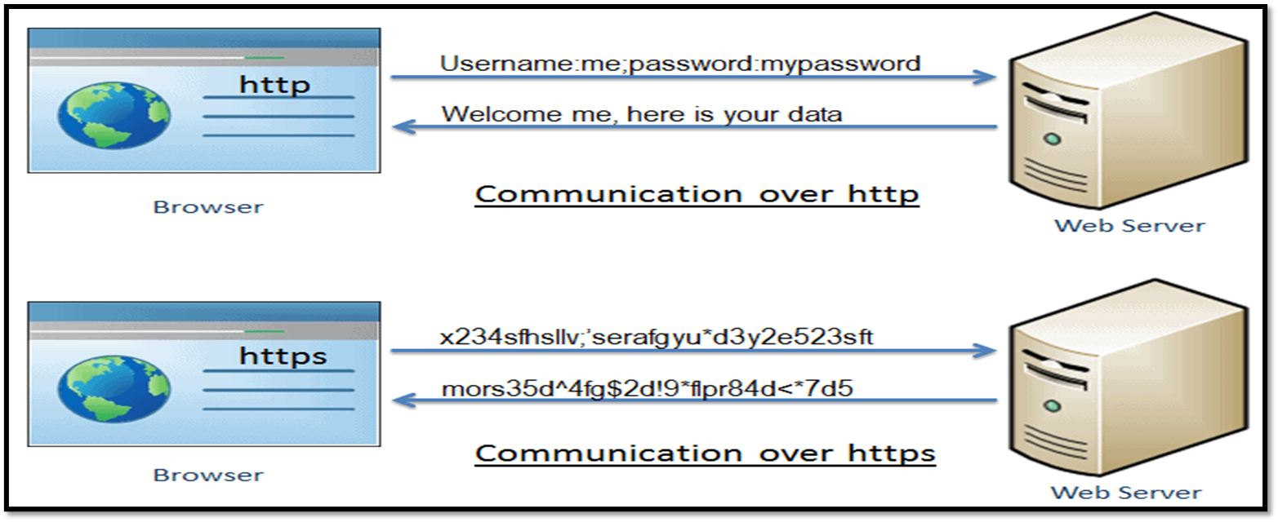
Hypertext Transfer Protocol Secure
Notes:
HTTPS establishes the communication between the browser and the webserver. It uses the Secure Socket Layer (SSL) and Transport Layer Security (TLS) protocol for establishing communication. The new version of SSL is TSL.
HTTPS uses the conventional HTTP protocol and adds a layer of SSL/TSL over it. The workflow of HTTP and HTTPS remains the same, the browsers and servers still communicate with each other using the HTTP protocol. However, this is done over a secure SSL connection. The SSL connection is responsible for the encryption and decryption of the data that is being exchanged in order to ensure data safety.

Slide 47
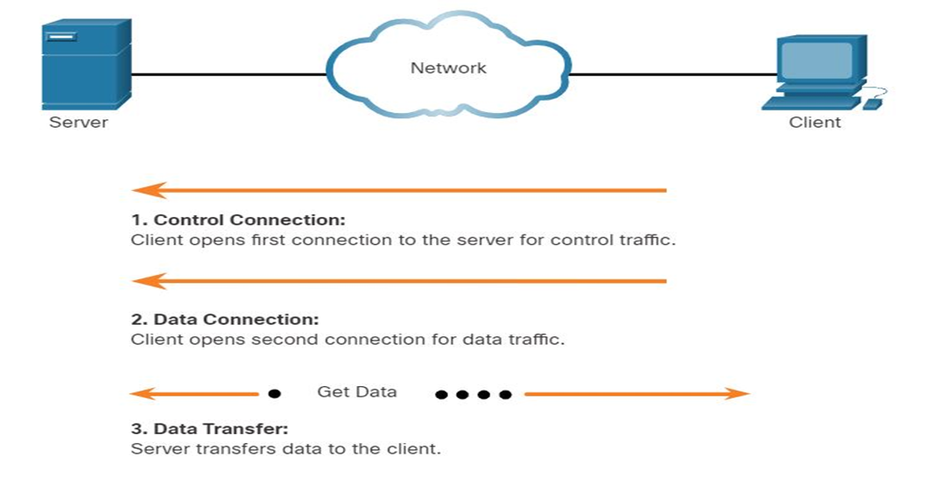
File Transfer Protocol
FTP was developed to allow for data transfers between a client and a server.
An FTP client is an application which runs on a computer that is being used to push and pull data from an FTP server.
Notes:
The client establishes the first connection to the server for control traffic using TCP port 21. The traffic consists of client commands and server replies.
The client establishes the second connection to the server for the actual data transfer using TCP port 20. This connection is created every time there is data to be transferred.
The data transfer can happen in either direction. The client can download (pull) data from the server, or the client can upload (push) data to the server.

Slide 48
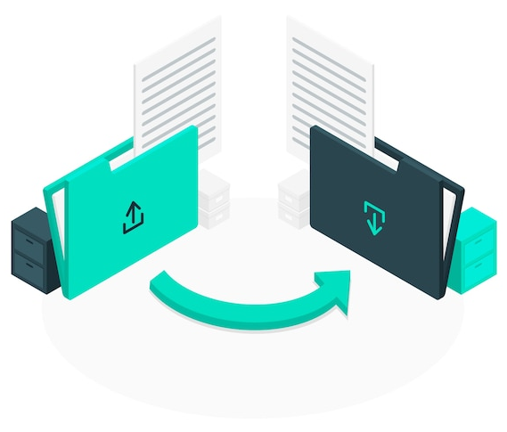
SSH
SSH is a software package that enables secure system administration and file transfers over insecure networks. It is used in nearly every data center and in every large enterprise.
Notes:
SSH service was created as a secure replacement for the unencrypted Telnet and uses cryptographic techniques to ensure that all communication to and from the remote server happens in an encrypted manner. It provides a mechanism for authenticating a remote user, transferring inputs from the client to the host, and relaying the output back to the client.

Slide 49
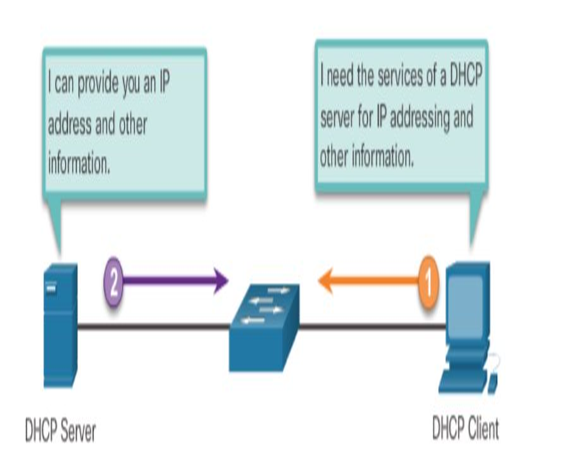
Dynamic Host Configuration Protocol
Dynamic Host Configuration Protocol (DHCP) is a network protocol that is used to configure network devices to communicate on an IP network.
Notes:
DHCP
assigns IPv4 addresses and other network configuration information dynamically
useful and timesaving tool for network administrators
dynamically assigns, or leases, an IPv4 address from a pool of addresses

Slide 50

Summary
Cloud Computing is an answer to ever-increasing need of computation power.
Azure is a cloud solution from Microsoft.
We have different delivery and deployment models in Cloud environment.
Knowing how packets are transmitted and delivered gives you a better understanding of what can happen to packets as they travel from source to destination.
A VPN connection establishes a secure connection between you and the internet.
Notes:
Cloud Computing is an answer to ever-increasing need of computation power.
Azure is a cloud solution from Microsoft.
We have different delivery and deployment models in Cloud environment.
Knowing how packets are transmitted and delivered gives you a better understanding of what can happen to packets as they travel from source to destination.
A VPN connection establishes a secure connection between you and the internet.
50

Slide 51

Quiz
1. What is cloud computing?
Storing data on physical devices
Accessing and managing data over the internet instead of on a local computer or server
Offline data processing
Using only private networks for data transfer
Answer: b
Accessing and managing data over the internet instead of on a local computer or server
Notes:
51

Slide 52
Quiz
2. Which of the following is NOT a benefit of cloud computing?
Scalability
Limited accessibility
Cost-effectiveness
Flexibility
Answer: b
Limited accessibility
Notes:
52

Slide 53
Quiz
3. What are the three primary service models in cloud computing?
Local, Remote, Hybrid
SaaS, PaaS, IaaS
Personal, Business, Enterprise
Free, Basic, Premium
Answer: b
SaaS, PaaS, IaaS
Notes:
53

Slide 54
Quiz
4. Which cloud service model provides virtualized computing resources over the internet?
SaaS
PaaS
IaaS
DaaS
Answer: c
IaaS
Notes:
54

Slide 55
Quiz
5. Which cloud deployment model involves sharing resources among multiple organizations on the same physical hardware?
Public Cloud
Private Cloud
Hybrid Cloud
Community Cloud
Answer: a
Public Cloud
Notes:
55

Slide 56
Quiz
6. What does the term "elasticity" mean in the context of cloud computing?
The ability to access cloud services from anywhere
The ability to scale computing resources up or down based on demand
The use of only private networks for data transfer
The security measures applied to data in the cloud
Answer: b
The ability to scale computing resources up or down based on demand
Notes:
56

Slide 57
Quiz
7. Which programming languages can be used to develop applications on Azure?
English and Spanish
JavaScript only
Any programming language
Only Microsoft-developed languages
Answer: c
Any programming language
Notes:
57

Slide 58
Quiz
8. What is an Azure Virtual Machine (VM)?
A physical server maintained by Azure.
A specialized networking device.
A virtualized instance of a computer running an operating system.
A cloud storage service.
Answer: c
A virtualized instance of a computer running an operating system.
Notes:
58

Slide 59
References
What is cloud computing? A beginner’s guide | Microsoft Azure
Cloud Deployment Model - javatpoint
Cloud Service Models - javatpoint
https://www.ibm.com/docs/en/i/7.3?topic=networking-concepts
https://www.techtarget.com/searchnetworking/definition/subnet#:~:text=One%20goal%20of%20a%20subnet,space%2C%20improves%20address%20allocation%20efficiency.
https://www.geeksforgeeks.org/explain-working-of-https/
https://www.freepik.com/
Notes:
59

Slide 60
Thank You!
Notes:
Thank you!
60

